Slide 1
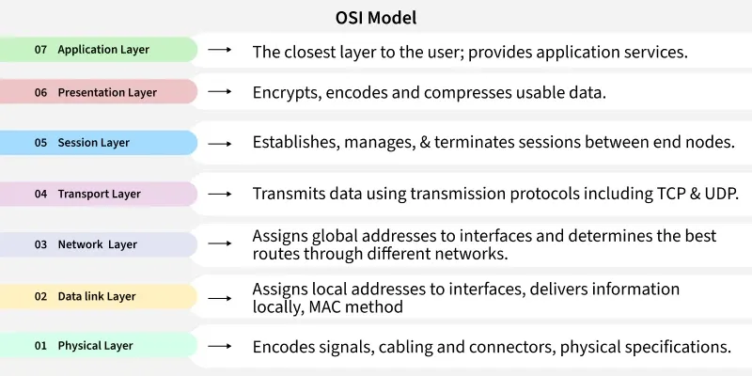
How Data Moves Through the OSI Model

Slide 2
TCP/IP
TCP/IP is a practical communication model that explains how data is created, transmitted, and received across networks. It is the foundation of the internet and is used by all modern devices for communication.
TCP/IP is needed to ensure different devices and networks follow common rules to communicate smoothly. It provides reliable data transfer, proper addressing, and supports essential services like web browsing and email.
TCP/IP won because it was simpler, faster to implement, and already used in real networks before OSI was completed. It became the global standard for the internet, while OSI stayed mostly theoretical.

